Slide 1
LIMASSOL SPACE APPS 2017
Agreenspace

Slide 2
Our Challenge
After reading the challenges that NASA gave us this year, the idea of settling human life on Mars inspired our team.
As future agriculturists and biotechnologists we would like to upgrade the living conditions in HI-SEAS project and contribute to the establishment of life on planet Mars as well.

Slide 3
We studied the analog habitat of human spaceflight to Mars (HI-SEAS) and we got to know the everyday difficulties that the volunteers have faced during their stay there.
We came up with possible solutions for some of their problems, combining them simultaneously with our “green vision”.

Slide 4
Difficulties in HI-SEAS
Little space
Signs of depression
Lack of fresh food
Need for supplementary energy source

Slide 5
Difficulties on Mars
Cold weather
Lack of sunlight
Muscle atrophy
Bone thinning

Slide 6
Simple and possible solutions
We noticed that the equipment in the hab were rather offhand and could be more ergonomic and can be used in more than one ways.
For example the mechanic energy of moving devices and equipments such as workout machines can be a source of electricity.

Slide 7
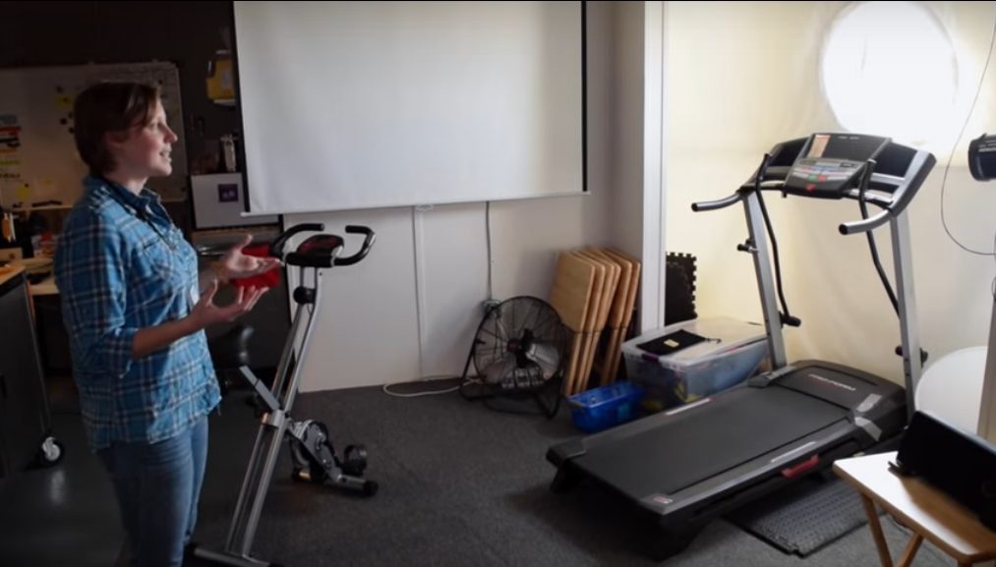
Current exercise equipment

Slide 8
Electricity Generating Bicycle
As the crew already needs to exercise daily, why not combine it with generating electricity?
A basic generator bicycle can produce approximately 100 watts per hour of exercise
So a crew of 6 people can produce a total of 18 kWh per month (100x6x30)

Slide 9
That’s not a huge amount of energy that can support the whole dome with electricity but it can power some low consumption devices
Additionally, a percentage of the energy produced every month can be stored in a power saving battery of high capacity as a backup source for emergency situations.

Slide 10
Power competition
Simultaneously this can turn into a fun activity as the crew can compete against each other, in order to produce the highest monthly amount of electricity.

Slide 11
Specifications
Workout bicycle with stand: -Light material -Foldable skeleton
Screen panel for data, such as: - Burned Calories - Speed -Distance - Produced energy - Total saved power indication
Drive belt
Motor
Battery
Inverter
Sockets

Slide 12
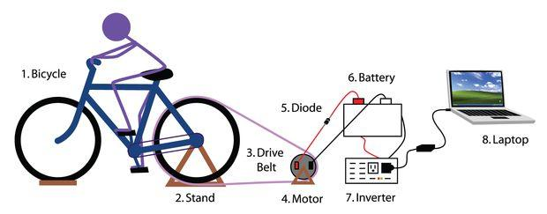
The mechanism
This mechanism is based on the conversion of kinetic energy into magnetic and then into electricity.
Basically the production of the secondary source of energy will be based on working principle of the “Free Electric Bike” invented by Manoj Bhargava. Specifically the mechanic energy from the pedaling causes the production of magnetic energy in the motor which then converts into electricity.
This principle can be also used for other workout equipment and electronic devices.

Slide 13
Uses of produced electricity
LED Lamps for lighting
Mixer
Fan
Computer
UV Lamps for cultivation
Etc

Slide 14
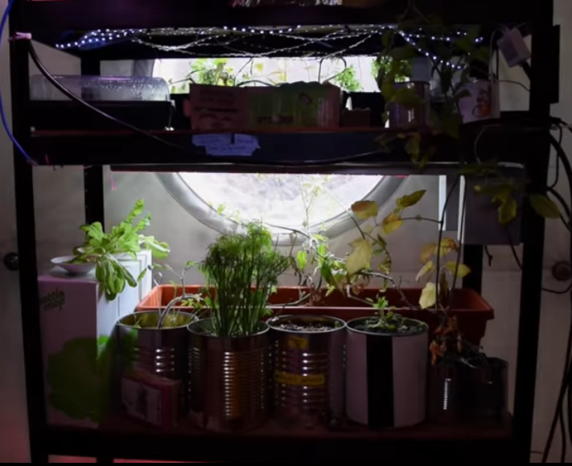
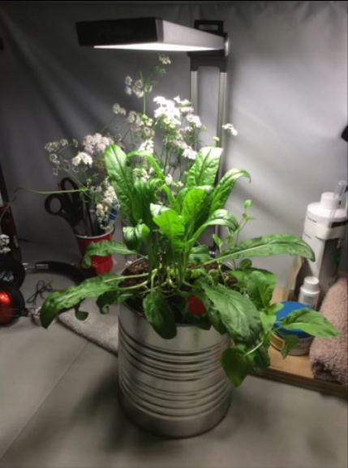
Current cultivation effort

Slide 15
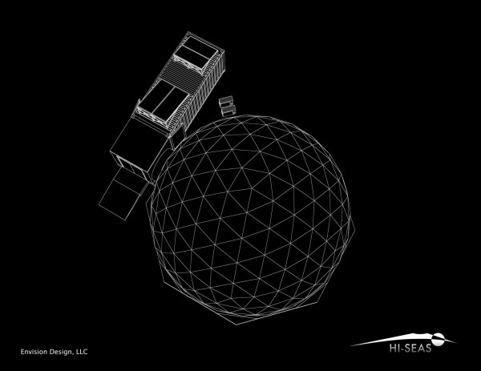
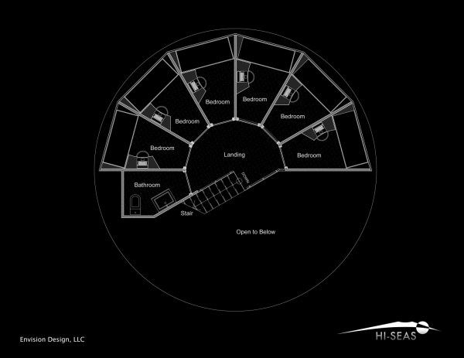
Green-floor
The hab
2nd floor

Slide 16
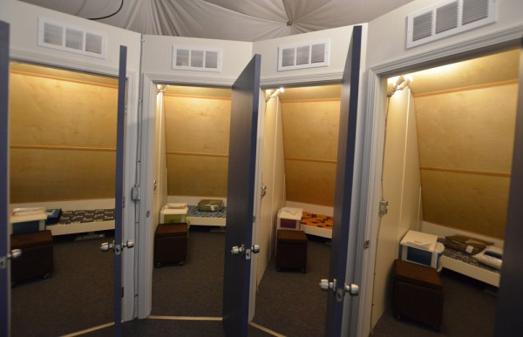
As you can see there is a lot of free space on the ceiling above the landing
Why not use it as a mini-indoor garden?

Slide 17
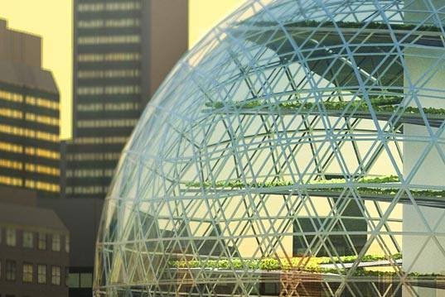
The green-floor:
Will be a source of fresh and nutritious food
Will not use needed space from the dome as the ceiling is not utilized anyway
Will have a positive impact on human psychology and mental health and will satisfy their natural instinct of biophilia
Supplementary source of oxygen
Example of indoor floor gardening

Slide 18
Details
The green-floor should be directly exposed to sunlight, thus the material of the dome wall above must be transparent and could be equipped with clear thin film photovoltaics
It should be keeping a constant temperature by using UV lamps ideal for cultivation which would be placed around the dome
The green-floor is going to be a separate floor that is going to be entered with a telescopic ladder system

Slide 19
Cultivating Plants
Ideal characteristics
Suggestions
The cultivating plants should preferably be:
Short
Low maintenance needs
Make edible crops
Produce high levels of oxygen
Snake plant
Potatoes
Tomatoes
Legumes
Onios
Beetroot
Radish

Slide 20
Visual representation

Slide 21
Conclusion
So as you can see our team deals with an issue of global importance.
Overcoming the electricity difficulties and the food and nutrition problems that the crew of HI-SEAS are facing now is important for the success of the first colonizers of Mars in the future.

Slide 22
THANK YOU FOR YOUR ATTENTION

